Slide 1

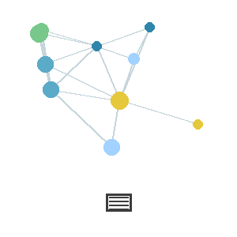
SMART KOPARGOAN HACKATHON
Grand Finale
SKH
SANJIVANI
UNIVERSITY
PART B: NEW PROBLEM STATEMENT / CHALLENGE
TITLE PAGE
Problem Statement ID – skh052
Problem Statement Title – Resource-Constrained Civic Decision & Response Platform for Kopargaon (via SKH020, government records lane)
Challenge Assigned (Live Scenario) – Data-Store Blackout + Misinformation/Fake-Submission
Theme– Digital Governance
PS Category- Software
Team ID– 56EGZG
Team Name (Registered on portal) - PaperTrail
sanjivani.edu.in
skh.sanjivaniuniversity.com

Slide 2
PAPERTRAIL
CHALLENGE RESPONSE
Your Solution's Response to the Live Scenario
How your system responded to the live scenario
Data Loss: Added backup memory to recover active data after storage failure.
False Information: Checks reports/images and flags suspicious submissions.
Safe Decisions: Suspicious data is held for verification before affecting the system.
Key decisions made and the reasoning behind them
Keep recent data in temporary memory.
Verify recovered data using SHA-256.
Flag and quarantine suspicious submissions instead of deleting them.
What was demonstrated live to the judges
Simulated data wipe → recovered data.
Verified records → detected changes.
Submitted suspicious image/report → flagged for review.
sanjivani.edu.in
skh.sanjivaniuniversity.com
2

Slide 3
PAPERTRAIL
IMPLEMENTATION, FEASIBILITY & IMPACT
Technologies/tools used to build the response within the challenge window
JavaScript / React
Web Crypto (SHA-256)
HTML Canvas
Leaflet Maps
QR Code
Feasibility – challenges faced and how they were overcome
Storage failure → Recovery buffer.
Fake submissions → Verification + quarantine.
Unclear decisions → Show reasons for the result.
Impact – how this response strengthens your original solution's real-world readiness
Better data recovery
Safer decisions
Tamper detection
More transparent system
sanjivani.edu.in
skh.sanjivaniuniversity.com
3

Slide 4
PAPERTRAIL
IMPORTANT INSTRUCTIONS
The presentation must not exceed 4 slides, including the Title Slide.
Present your response using bullet points, diagrams, or relevant visuals instead of lengthy paragraphs.
Keep the content clear, concise, and directly tied to the challenge you were given.
Focus on what was actually built and demonstrated live during the challenge window — not planned or hypothetical work.
Use only the official presentation template provided. Do not modify the template structure, slide sequence, or the required sections.
sanjivani.edu.in
skh.sanjivaniuniversity.com
4

